Slide 1
University American College Skopje
Course: Business Computer Applications
Getting the most from Excel – level I
Marija Stanojeska, PhD

Slide 2

Based on the textbook:
Microsoft Office Inside Out (Office 2021 and Microsoft 365), J. Habraken, Pearson Education, Inc., 2022.

Slide 3
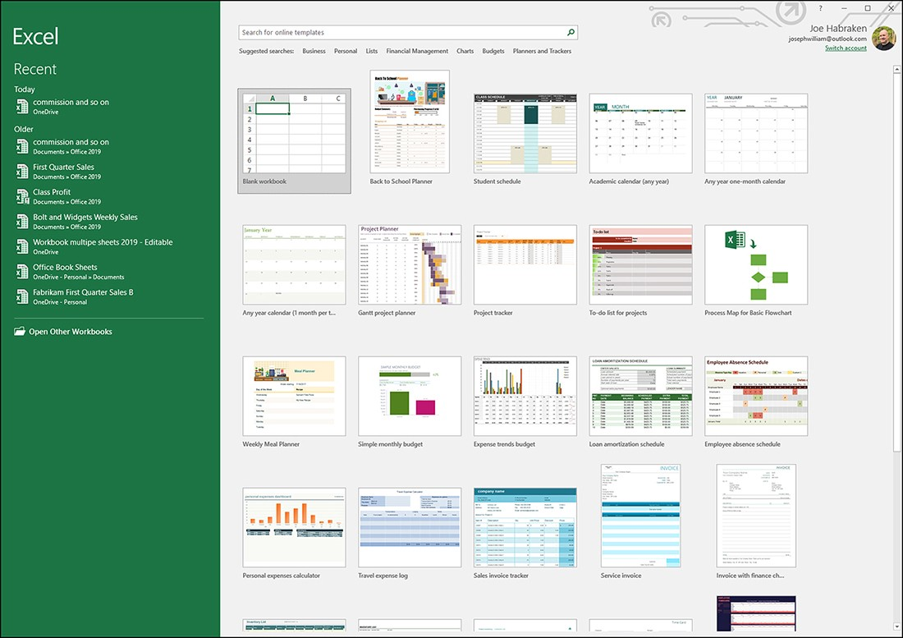
The new page in the Excel backstage
When you start Excel (or Word or PowerPoint), the Start screen provides a list of recently accessed ﬁles; it also provides a number of templates including the blank workbook template to quickly get you up and running with a new Excel workbook. You will ﬁnd that the entire Excel Backstage has been re-envisioned to make it easier for you to both save and access your ﬁles.

Slide 4
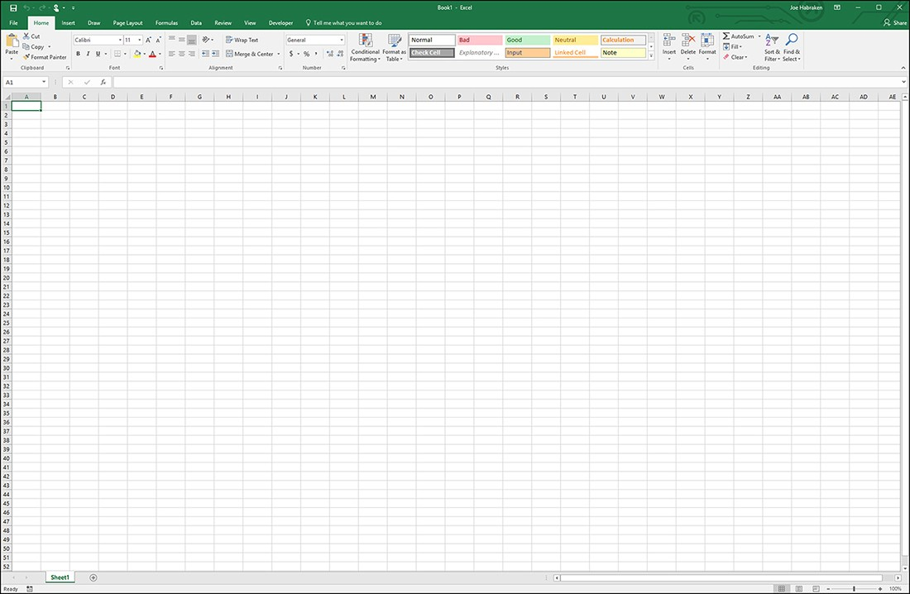
The Excel window and a new blank Excel workbook
As with the other Oﬃce applications, the tools and features you use to build and then enhance your Excel workbook are found on the ribbon and its various tabs. A single Excel sheet actually has 16,384 columns and 1,048,576 rows, which means a single sheet has a lot of room for your data and calculations. You also have the ability to create a nearly endless number of sheets, so I would not worry about running out of space as you work in this powerful application.

Slide 5
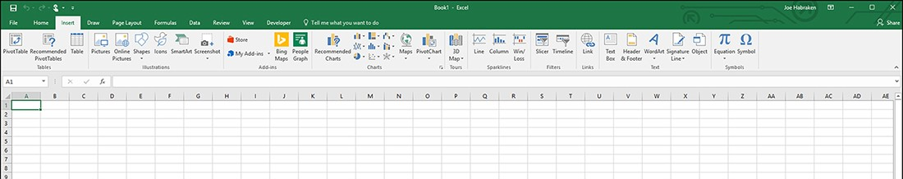
The Excel ribbon
The ribbon sits at the top of the Excel application window and provides access to the commands and tools you use as you work on your Excel worksheet:
  Home
  Insert
  Page layout
  Formulas
  Data Review
  View

Slide 6
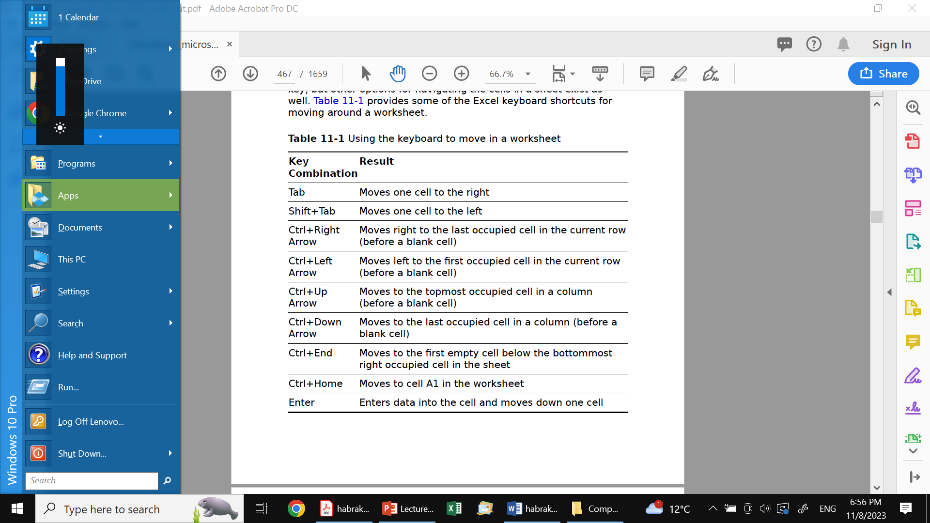
Moving around a worksheet
The arrow keys move you one cell in the direction speciﬁed by the key, but other options for navigating the cells in a sheet exist as well. Table provides some of the Excel keyboard shortcuts for moving around a worksheet.
The mouse also gives you other possibilities for interacting with the worksheet cells. You can double-click in a cell to place the insertion point and edit the data directly in the cell. You can also click directly in the formula bar and edit the current cell entry there. You can use the mouse to zoom in or out on the current worksheet: Hold down the Ctrl key and then use the mouse wheel to zoom in or out as needed.

Slide 7
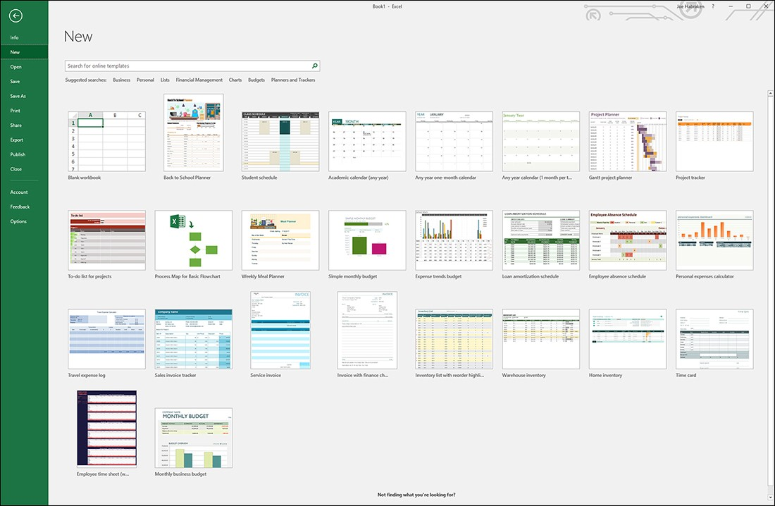
Creating workbooks and worksheets
If you are already working on a workbook in Excel and you would like to open a new workbook, you can quickly access the New page in the Excel Backstage.
Select File and then New.

Slide 8
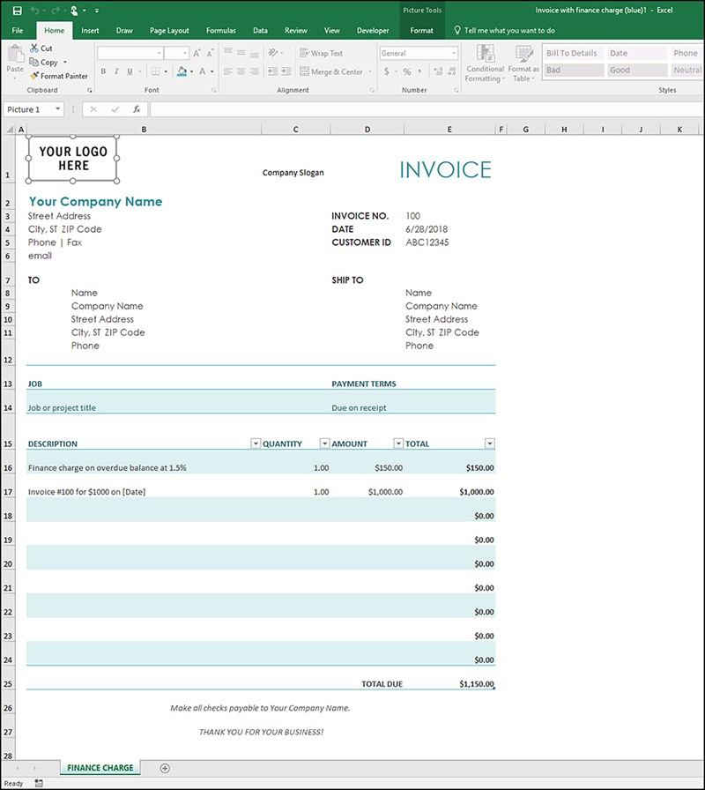
Using Oﬃce.com templates
Oﬃce.com provides you with diﬀerent types of Excel templates; you can download budgets, calendars, invoices, plans, and schedules. To view the templates available in one of the template groups, select a group such as Invoices. The number of templates available in a particular group depends on the group you have selected. Each group provides several possibilities.
Select File > New > Search for online templates

Slide 9
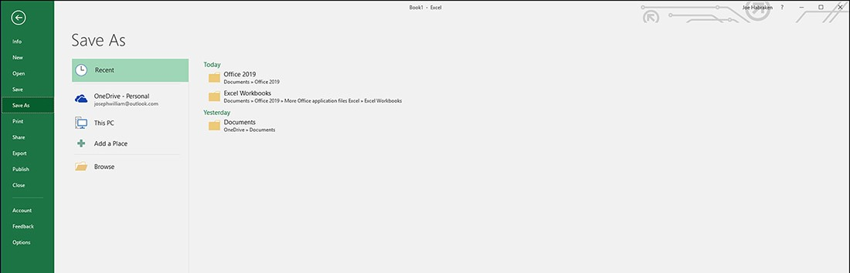
Managing Excel workbooks
The ﬁrst time you save a new workbook, Excel takes you to the Save As page in the Backstage. The Save As page shows the various places where you can save the new Excel workbook.
File > Save as

Slide 10
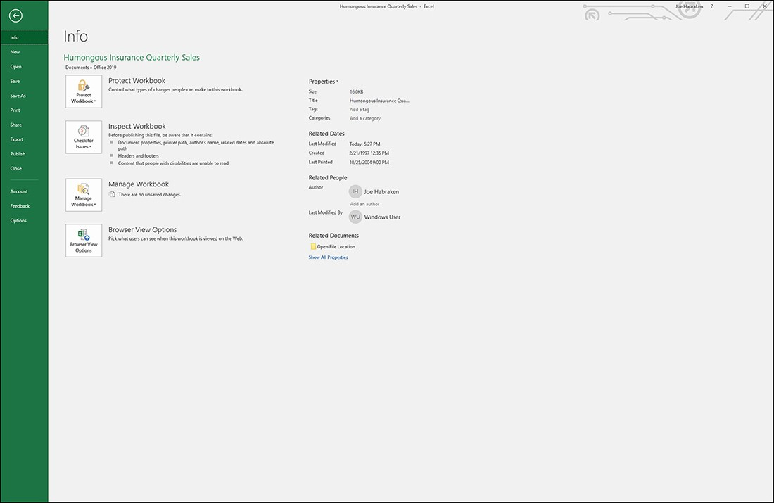
Managing Excel workbooks (cont.)
Another Backstage page that provides you with workbook management tools is the Backstage Info page. This page provides access to the workbook protection settings (Protect Workbook) and privacy and compatibility settings (Check For Issues); all these settings can be an issue if you are going to Share (Publish) this workbook with other users. The Info page provides access to the diﬀerent versions of your workbook that the Autosave feature has created.
File > Backstage > Info

Slide 11
Protecting workbooks and worksheets
The Protect Workbook command in the Info window provides these possibilities:
File > Backstage > Info > Protect Workbook
Mark As Final: This command marks the ﬁle as ﬁnal and makes it read-only. All editing commands for the ﬁle are disabled.
Encrypt With A Password: The ﬁle is encrypted and protected with a password. When you select this option, you are required to enter a password for the workbook. Only users with the password can open the workbook.
Protect Current Sheet: This option opens the Protect Sheet dialog box, which enables you to password-protect the sheet or specify individual sheet-related capabilities, such as Format Cells, Insert Hyperlinks, and Delete Columns.
Protect Workbook Structure: You can use this option to keep users from changing the number of sheets in the workbook. This means that worksheets cannot be deleted or added.
Restrict Access: This option enables you to connect to a Digital Rights Management server, which gives you the capability to assign users diﬀerent permission levels based on user authentication.
Add A Digital Signature: You can digitally sign a ﬁle to prove its authenticity. Signing a ﬁle digitally requires that you obtain a digital certiﬁcate from a certiﬁcate authority (you can locate a digital certiﬁcate authority on the web).

Slide 12
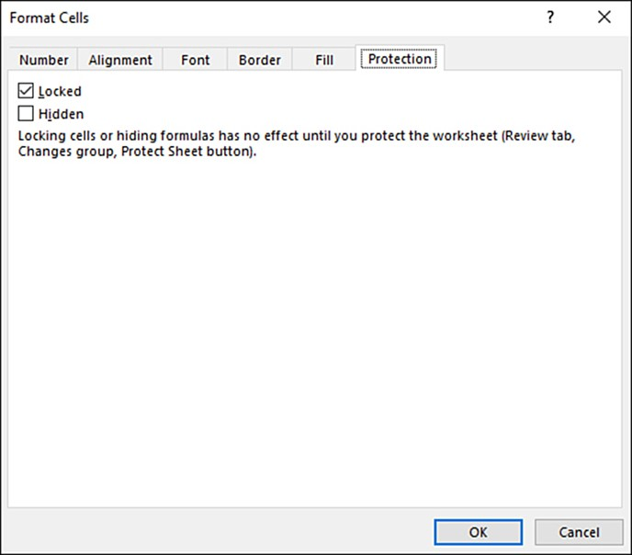
Locking cells
Select the cells in the worksheet that you want to lock. These can be cells containing formulas, functions, or column and row labels. On the Home tab, select the Format command in the Cells group. Then select Format Cells dialog box. Select the Protection tab in the dialog box. The Locked check box should already be selected by default.
Select cell > right click >
Format cells > Protection > OK

Slide 13
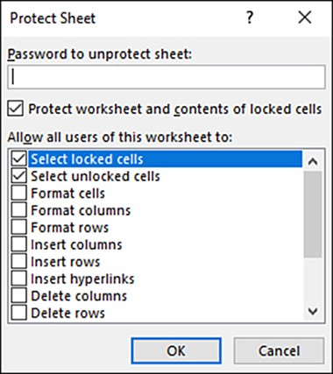
Protect Sheet
Select the ribbon’s Review tab and then select the Protect Sheet command in the Changes group.
The Protect Sheet dialog box opens. You can enter a password to protect the sheet, if you want.
You can also select other options related to what users can do to the worksheet, such as formatting cells, columns, or rows and inserting hyperlinks.
To protect the locked cells on the sheet and allow data entry in other cells, you need not change any of the settings in the Protect Sheet dialog box.
Even the password is optional. Click OK to close the dialog box.
Home tab > Review > Protect Sheet > OK

Slide 14
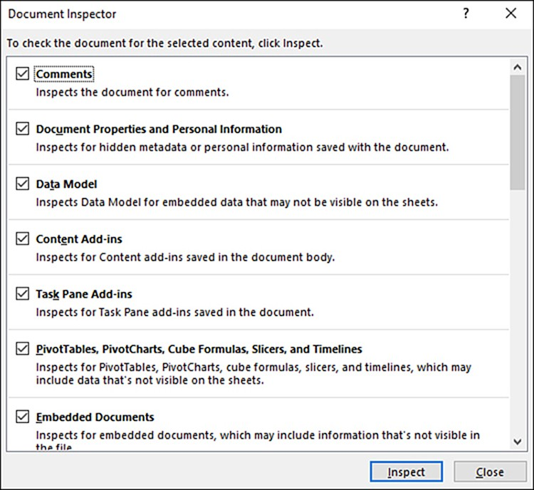
Preparing a workbook for sharing
The Check For Issues button in the Backstage Info window (from the Excel application window select File) provides commands that enable you to check a workbook for hidden or personal information and for any accessibility or compatibility issues with the workbook. When you select the Inspect Document command, the Document Inspector opens. When the inspection has completed, a list of results appears in the Document Inspector.
Home > Backstage >
Check for issues >
Inspect Document

Slide 15
Entering data in a worksheet
Entering data in a worksheet is just a matter of accessing a particular cell and then entering the information you want in that cell. Unlike Word, where you primarily enter text, Excel allows you to enter an array of diﬀerent types of information. So, your worksheet entries will typically include text, numbers, dates, times, formulas, and functions.
There are two distinct types of information:
  Labels
  Values
A label is descriptive information, such as the name of a person, place, or thing, or a time designation such as the day of the week or month of the year. A label has no numerical signiﬁcance in Excel.
A value is data that does have numerical signiﬁcance. Values can be numbers, dates, and times. Values can be acted upon by formulas and functions.

Slide 16
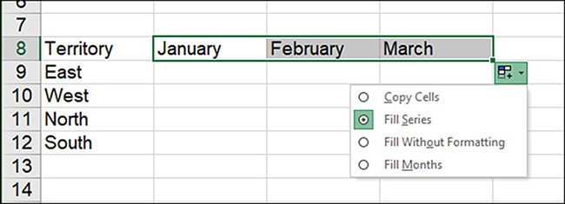
Using the Fill handle
To create a ﬁll series, such as the days of the week or months of the year, follow these steps:
Enter the ﬁrst item in the series.
Grab the Fill handle and drag in the appropriate direction to extend the series. ScreenTips appear as you drag across the cells, showing a preview of each item that will be placed in each subsequent cell.
Release the mouse to enter the series items.
When you release the mouse, the series items appear in the cells. The AutoFill Options button appears.

Slide 17
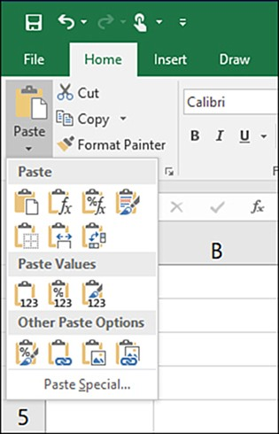
Copying, moving, and deleting cell contents
Copy-and-paste and cut-and-paste are pretty familiar to even the most Oﬃce user, and it is a very straightforward process to select a cell or cells, and then use the Copy.
There are Paste options that allow you to just paste the formatting of the source cells or paste the results of a formula rather than the formula itself. These diﬀerent Paste command possibilities can be used to paste information on the current worksheet, the current workbook
  Ctrl+C to copy
  Ctrl+X to cut
  Ctrl+V to paste

Slide 18
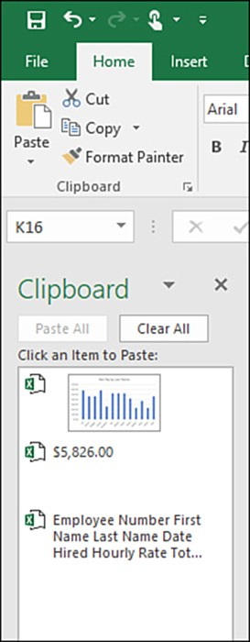
Copying, moving, and deleting cell contents (cont.)
To view the contents of the Clipboard, select the Clipboard launcher at the bottom right of the Clipboard group on the ribbon’s Home tab. The Clipboard appears as a pane on the left side of the Excel workspace.
The Oﬃce Clipboard can hold up to 24 items, which makes it easy to paste data from worksheet to worksheet or even to another Excel workbook.
When you place the mouse on an item stored in the Clipboard, a drop-down menu arrow appears.
You can use the menu to paste the item. You can also remove it from the Clipboard by selecting Delete on the drop-down menu.
You can paste all the items on the Clipboard using the Paste All command.
If you want to remove all the current items on the Clipboard, click the Clear All button.

Slide 19
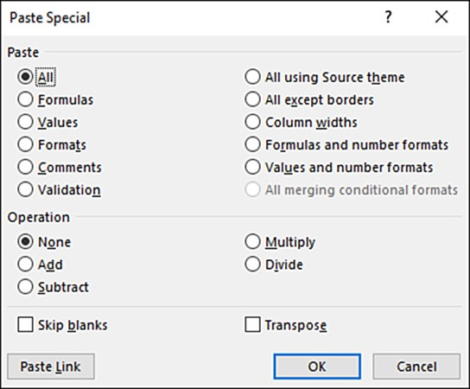
Using the Paste Special dialog box
The Paste gallery provides several possibilities in terms of how copied or cut content (in a cell or range) is then pasted to a new location. The Paste Special dialog box provides more options than the Paste gallery. Many of the options provided in the Paste Special dialog box relate to pasting cells (that have been copied or cut) from one worksheet to another worksheet, or cells from one workbook to another.

Slide 20
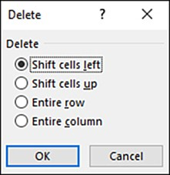
Clearing and deleting cells
To remove cells from a worksheet, select the cell or cell range and then select the Delete command in the Cells group of the ribbon’s Home tab. The Delete command provides a gallery that enables you to delete cells, rows, columns, or an entire worksheet. To open the Delete dialog box, select Delete Cells.

Slide 21
Printing worksheets
Printing in Excel is really a two-step process.
You will ﬁnd that the Page Layout tab of the ribbon provides all the commands you need to adjust the overall layout of the sheet, including page orientation, margins, and page sizes.
After you have adjusted the various page layout settings using the Page Layout tab, you can move on to the second half of the tasks related to printing and open the Backstage Print page. The Print page enables you to specify the printer for the printout and also conﬁgure other print settings, such as what is to be printed, how many copies should be printed, and how the printouts should be collated. Let’s look at the Page Layout command and then the Print page options.

Slide 22
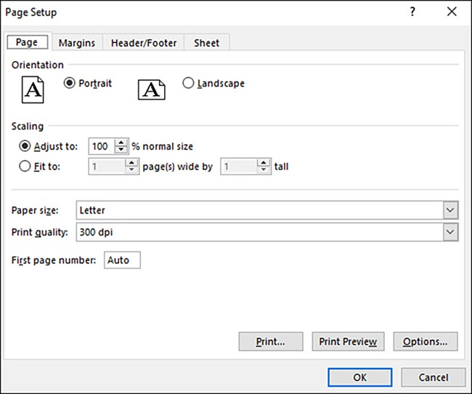
Using the Page Layout commands
The Page Setup group on the Page Layout tab provides commands that are important in terms of conﬁguring the page settings for the worksheet.
  Margins
  Orientation
  Size
  Print Area
  Breaks
  Background
  Print Titles

Slide 23
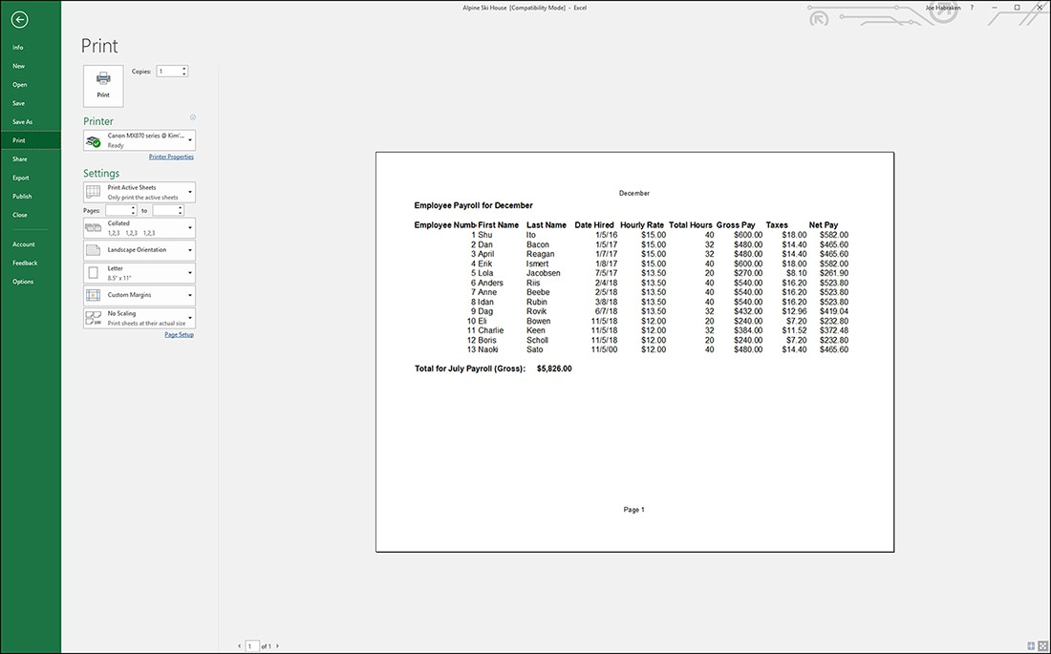
Working on the print page
When you have the Page Layout settings the way you want them, you can access the Backstage Print page to ﬁnalize settings for your sheet printout (you can actually print multiple sheets in a workbook). To access the Backstage, select File on the ribbon. In the Backstage, select Print.

Slide 24
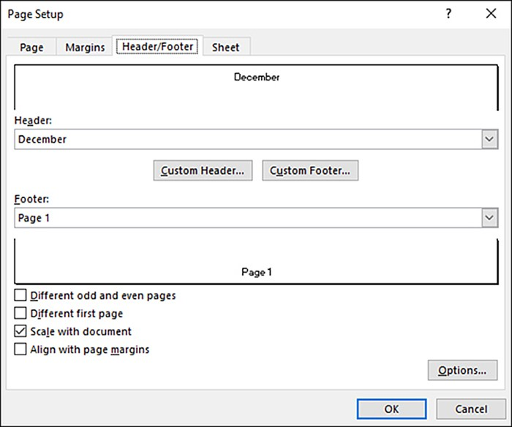
Inserting headers and footers
Headers and footers are used to place repeating information on the pages of your printout. To specify a header for the worksheet, click the Custom Header button. This opens the Header dialog box. You can specify a header for the left, center, and right sections of the worksheet.
Home > Insert > Header & Footer

Slide 25
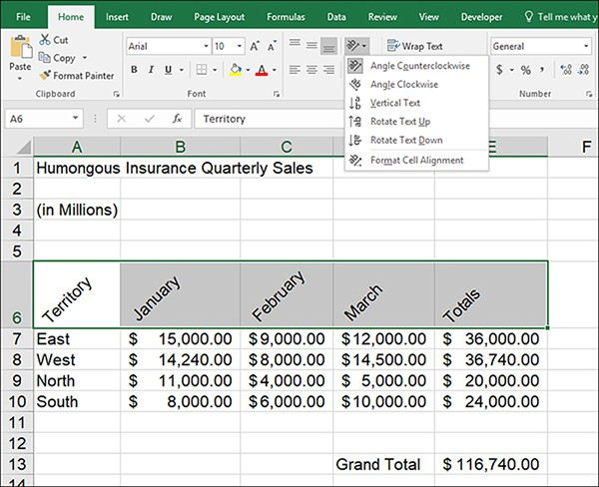
Changing text orientation
You can change the orientation of text in a range of cells by using the Orientation command in the Home tab’s Alignment group.
This is useful in cases where your labels must conform to very narrow columns or in cases where you want to align labels on the diagonal so that they are readily noticeable - or perhaps you just want to add a little bit of design drama to the top of the sheet.
Select the cell range that you want to format with the Orientation command. Then select Orientation in the Alignment group.
  Angle Counterclockwise
  Angle Clockwise
  Vertical Text
  Rotate Text Up
  Rotate Text Down
  Format Cell Alignment
Home tab > Number group (open)
> Format cells > Alignment

Slide 26
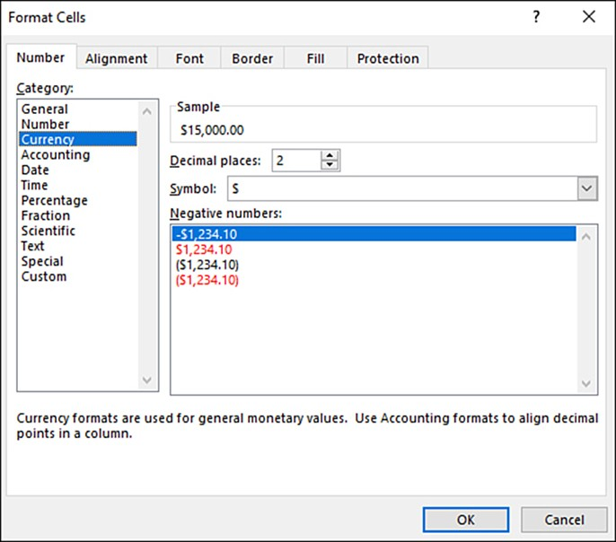
Formatting values
The shortest path for formatting numeric is to take advantage of the commands in the Number group on the ribbon’s Home tab.
This group provides commands related to speciﬁc number formats, such as the percent style, and it provides you with the ability to increase or decrease the decimal places in cell values. It also provides a gallery with access to several number formats.
The Number group commands are as follows:
  Number Format
  Accounting Number Format
  Percent Style
  Comma Style
  Increase Decimal
  Decrease Decimal
Home tab > Number group (open) > Format cells or
Home tab > Alignment > ab command

Slide 27
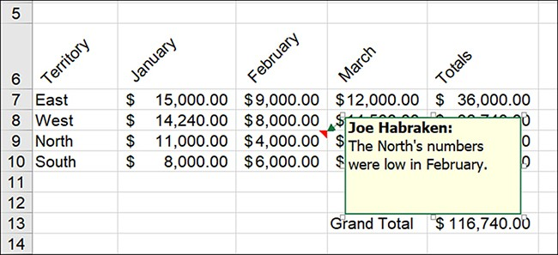
Adding comments to cells
To add a comment to a cell, click the cell to select it. You can then navigate to the Review tab of the ribbon and select the New Comment command, or you can right-click on a cell and then choose Insert Comment. A new Comment box opens. To view a cell’s comment, place the mouse on the cell. The Comment box opens. If you want to edit the comment, you can select the cell containing the comment and then click the Edit Comment command in the Comments group. You can add or delete text as needed.
Select cell > Review tab > New Comment

Slide 28
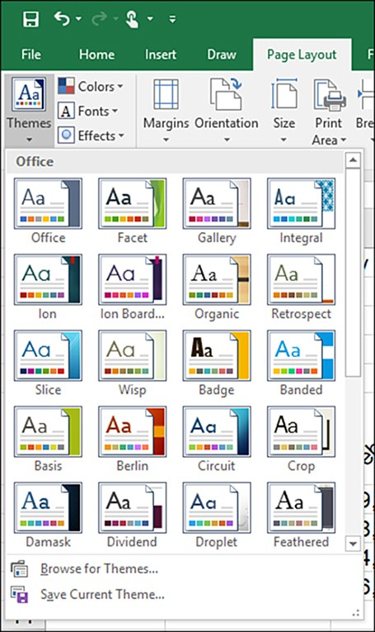
Using themes
The Themes gallery is accessed using the Themes command, which is available in the Themes group on the ribbon’s Page Layout tab. The Themes group also houses the Colors, Fonts, and Eﬀects commands.
Page layout tab > Themes

Slide 29
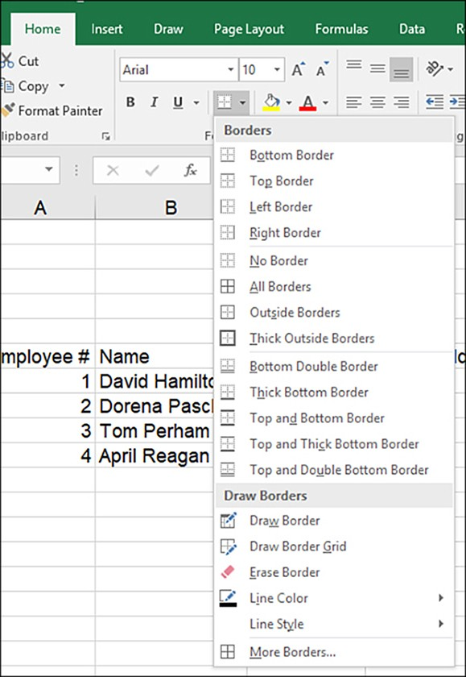
Adding cell borders
The Borders command provides a gallery of diﬀerent border types, such as Bottom Border, Top Border, All Borders, and so on.
Home tab > Borders

Slide 30
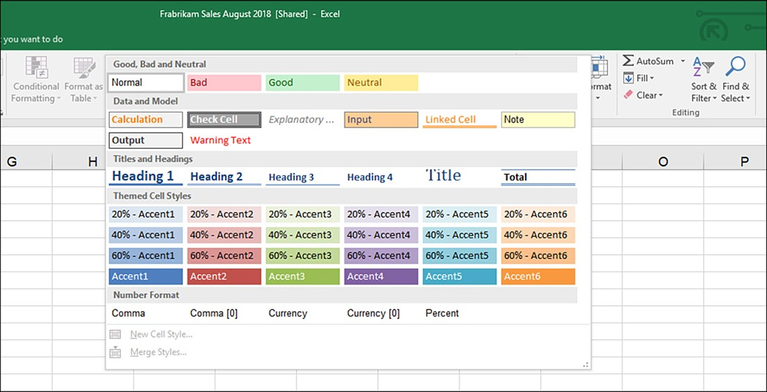
Using cell styles and the Format Painter
Excel provides speciﬁc cell styles for helping you denote cells that need to be checked or results that should be considered bad or good.
Other cell styles are provided speciﬁcally for headings and results, and there are also cell styles provided for number formatting. Other cell styles are provided speciﬁcally for headings and results, and there are also cell styles provided for number formatting. The Cell Styles command is in the Styles group on the Home tab. When you select the Cell Styles command, the Cell Styles gallery opens.
Home tab > Cell Styles

Slide 31
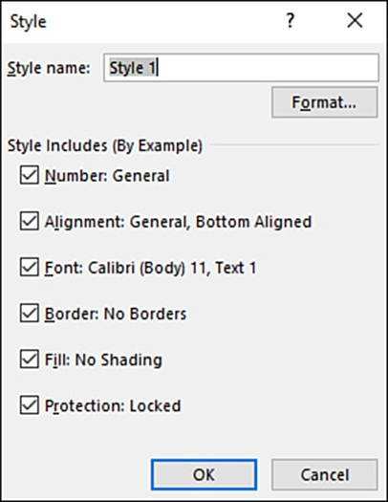
Creating a cell style
You can create a cell style by example. Format a cell or range of cells with font and cell attributes (such as font settings and border and ﬁll settings); you can also specify number formatting for the style by formatting the contents of the cell (or the cell range) with the diﬀerent number formats provided in the Number group or the Number Format gallery.
Select cell > Cell Style > New Cell Style

Slide 32
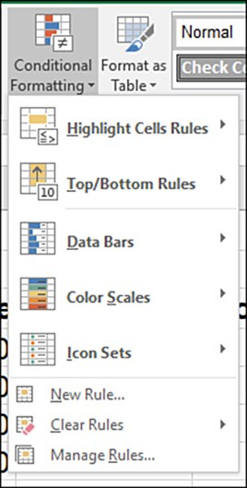
Using conditional formatting
When you select the Conditional Formatting command in the Styles group, the Conditional Formatting gallery opens. It provides you with several options related to applying conditional formatting to the selected range of cells in the sheet.
Select cells > Home tab > Conditional formatting

Slide 33
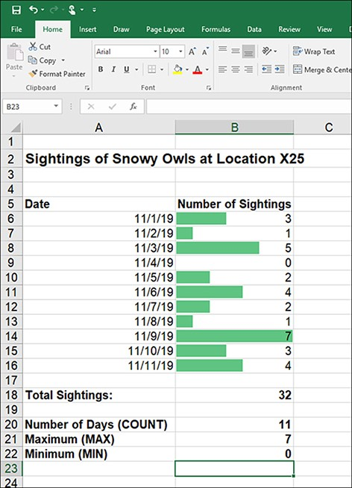
Using data bars
If you like to visually compare data in a range of cells without resorting to a chart or sparklines, you can take advantage of the data bars provided in the Conditional Formatting gallery.
The data bars are actually bar graphs that are placed in the cells of the selected range. This enables you to quickly see how the various values in the range compare with each other.
Select cells > Home tab >
Conditional Formatting > Data bars

Slide 34
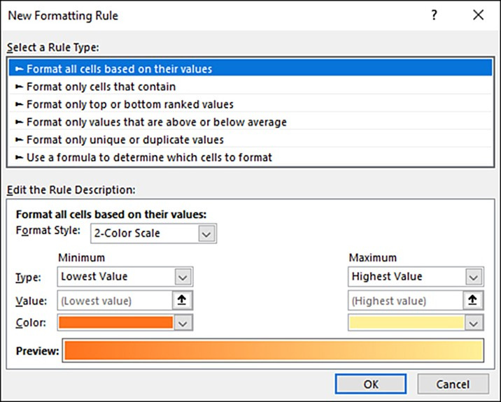
Creating conditional formatting rules
New rules are created in the New Formatting Rule dialog box. You can open this dialog box by selecting New Rule in the Conditional Formatting gallery, or you can select More Rules when you have accessed a rule category, such as Highlight Cells Rules or Color Scales.
Home tab > Conditional Formatting > New rule

Slide 35
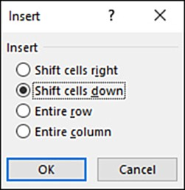
Inserting cells
You can insert single or multiple cells into a sheet. Inserting cells causes the data in the adjacent cells to shift down a row or over a column (to the right) to create a space for the new cells.
The number of cells inserted depends on the number of cells you select before inserting the new cells.
Home tab > Insert > Insert cells

Slide 36
Managing columns and rows
Inserting columns and rows
For inserting a single row, click in a cell in the row that you want to insert the new row below. Click the Insert command and select Insert Sheet Rows. The new row is inserted below the current row.
To insert multiple columns or rows, select the number of columns or rows you want to insert. In the case of columns, drag over the column headings; for rows, drag over the row numbers.
Deleting columns and rows
You can also delete a column or row from the sheet. In either case, select the column or row you want to remove by clicking the appropriate column or row heading (drag to select multiple columns or rows).
Select the Delete command in the Cells group and then select Delete Sheet Columns or Delete Sheet Rows, as needed.
Hiding columns and rows
In the case of columns, select the columns you want to hide. Select the Format command and then point at the Hide & Unhide option. Select Hide Columns, and the columns are hidden. The same process can be used for rows.
Home > Cells > Insert/ Delete/ Format

Slide 37
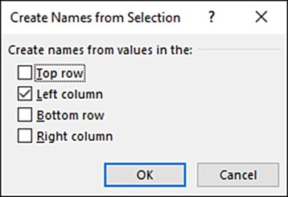
Creating range names from selections
You can also create range names based on the column labels or row labels that you have created in the worksheet. For example, if you have several columns of numbers, such as sales ﬁgures for diﬀerent regions by month (January, February, March), you can quickly create a range name for each of the columns using the column labels. To create range names from row or column labels, select the ranges (either in columns or rows) and make sure that you include the row or column containing the descriptive labels for the range. Then click the Create From Selection command in the Deﬁne Names groups.
Select row/column > Formulas > Create From Selection > Define Names group

Slide 38
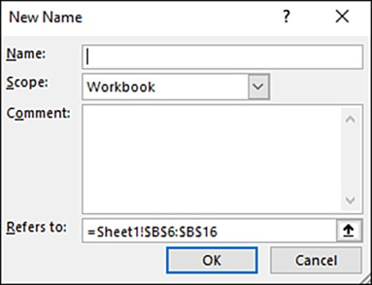
Naming ranges
There is more than one way to create range names. You can select a range of values and then deﬁne the name, or you can have Excel generate range names for the selected values using the column or row headings as the range names. To specify a range name for a selected range of cells, select the range and then click the Deﬁne Name command in the Deﬁned Names group of the ribbon’s Formulas tab.
Click on the row/column > Formulas > Define name

Slide 39
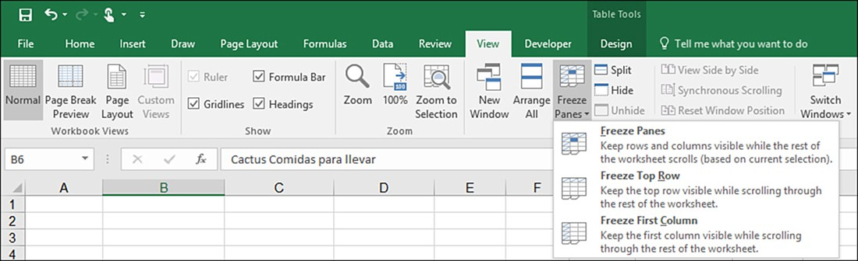
Freezing rows and columns
You can freeze your column and row labels so that they remain on the screen no matter how far you scroll to the right or scroll down in the sheet. The Freeze Panes command enables you to freeze panes (both column and row labels), freeze the top row (the column labels), or freeze the ﬁrst column (the row labels).
The Freeze Top Row and the Freeze First Column options on the Freeze Panes gallery are self-explanatory and require nothing from you other than just choosing one of these options after selecting the Freeze Panes drop-down arrow.
If you want to use the Freeze Panes option, you need to specify the rows and columns you want to freeze. This is accomplished by selecting the cell that is below the row you want to freeze and to the right of the column you want to freeze.
The Freeze Panes command is in the Zoom group on the ribbon’s View tab.

Slide 40
Useful links
https://support.office.com/en-us/article/video-sort-data-in-a-range-or-table-ffb9fcb0-b9cb-48bf-a15c-8bec9fd3a472
MS Excel Tutorial

Slide 41
Thank you for your attention!

